Slide 1
WELCOME PARENTS
CLASS OF 2021

Slide 2
Check list of items to be filled out and turned in by February 10th to the middle school
Registration Form / Home Language Survey/ New Student Enrollment Form
Course Request Form/ 4 Year Plan

Slide 3
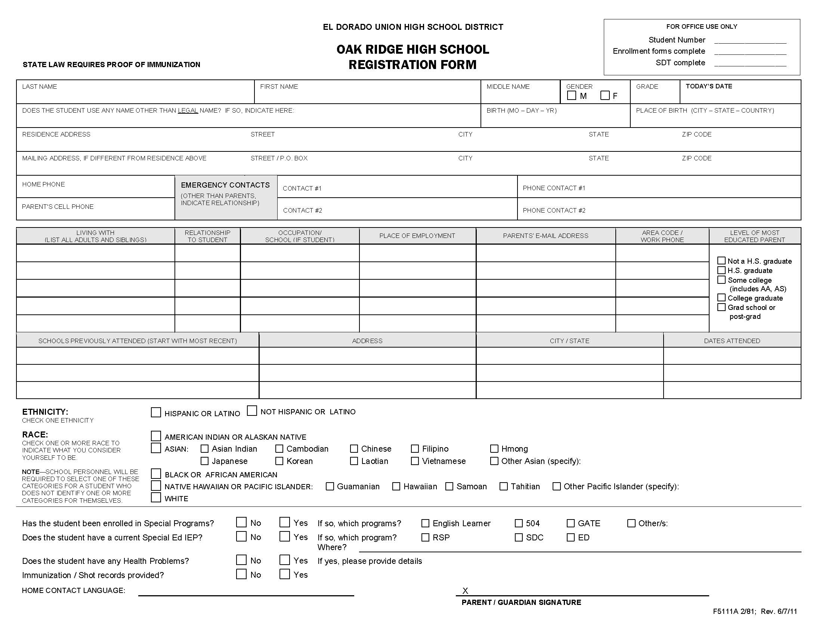

Slide 4
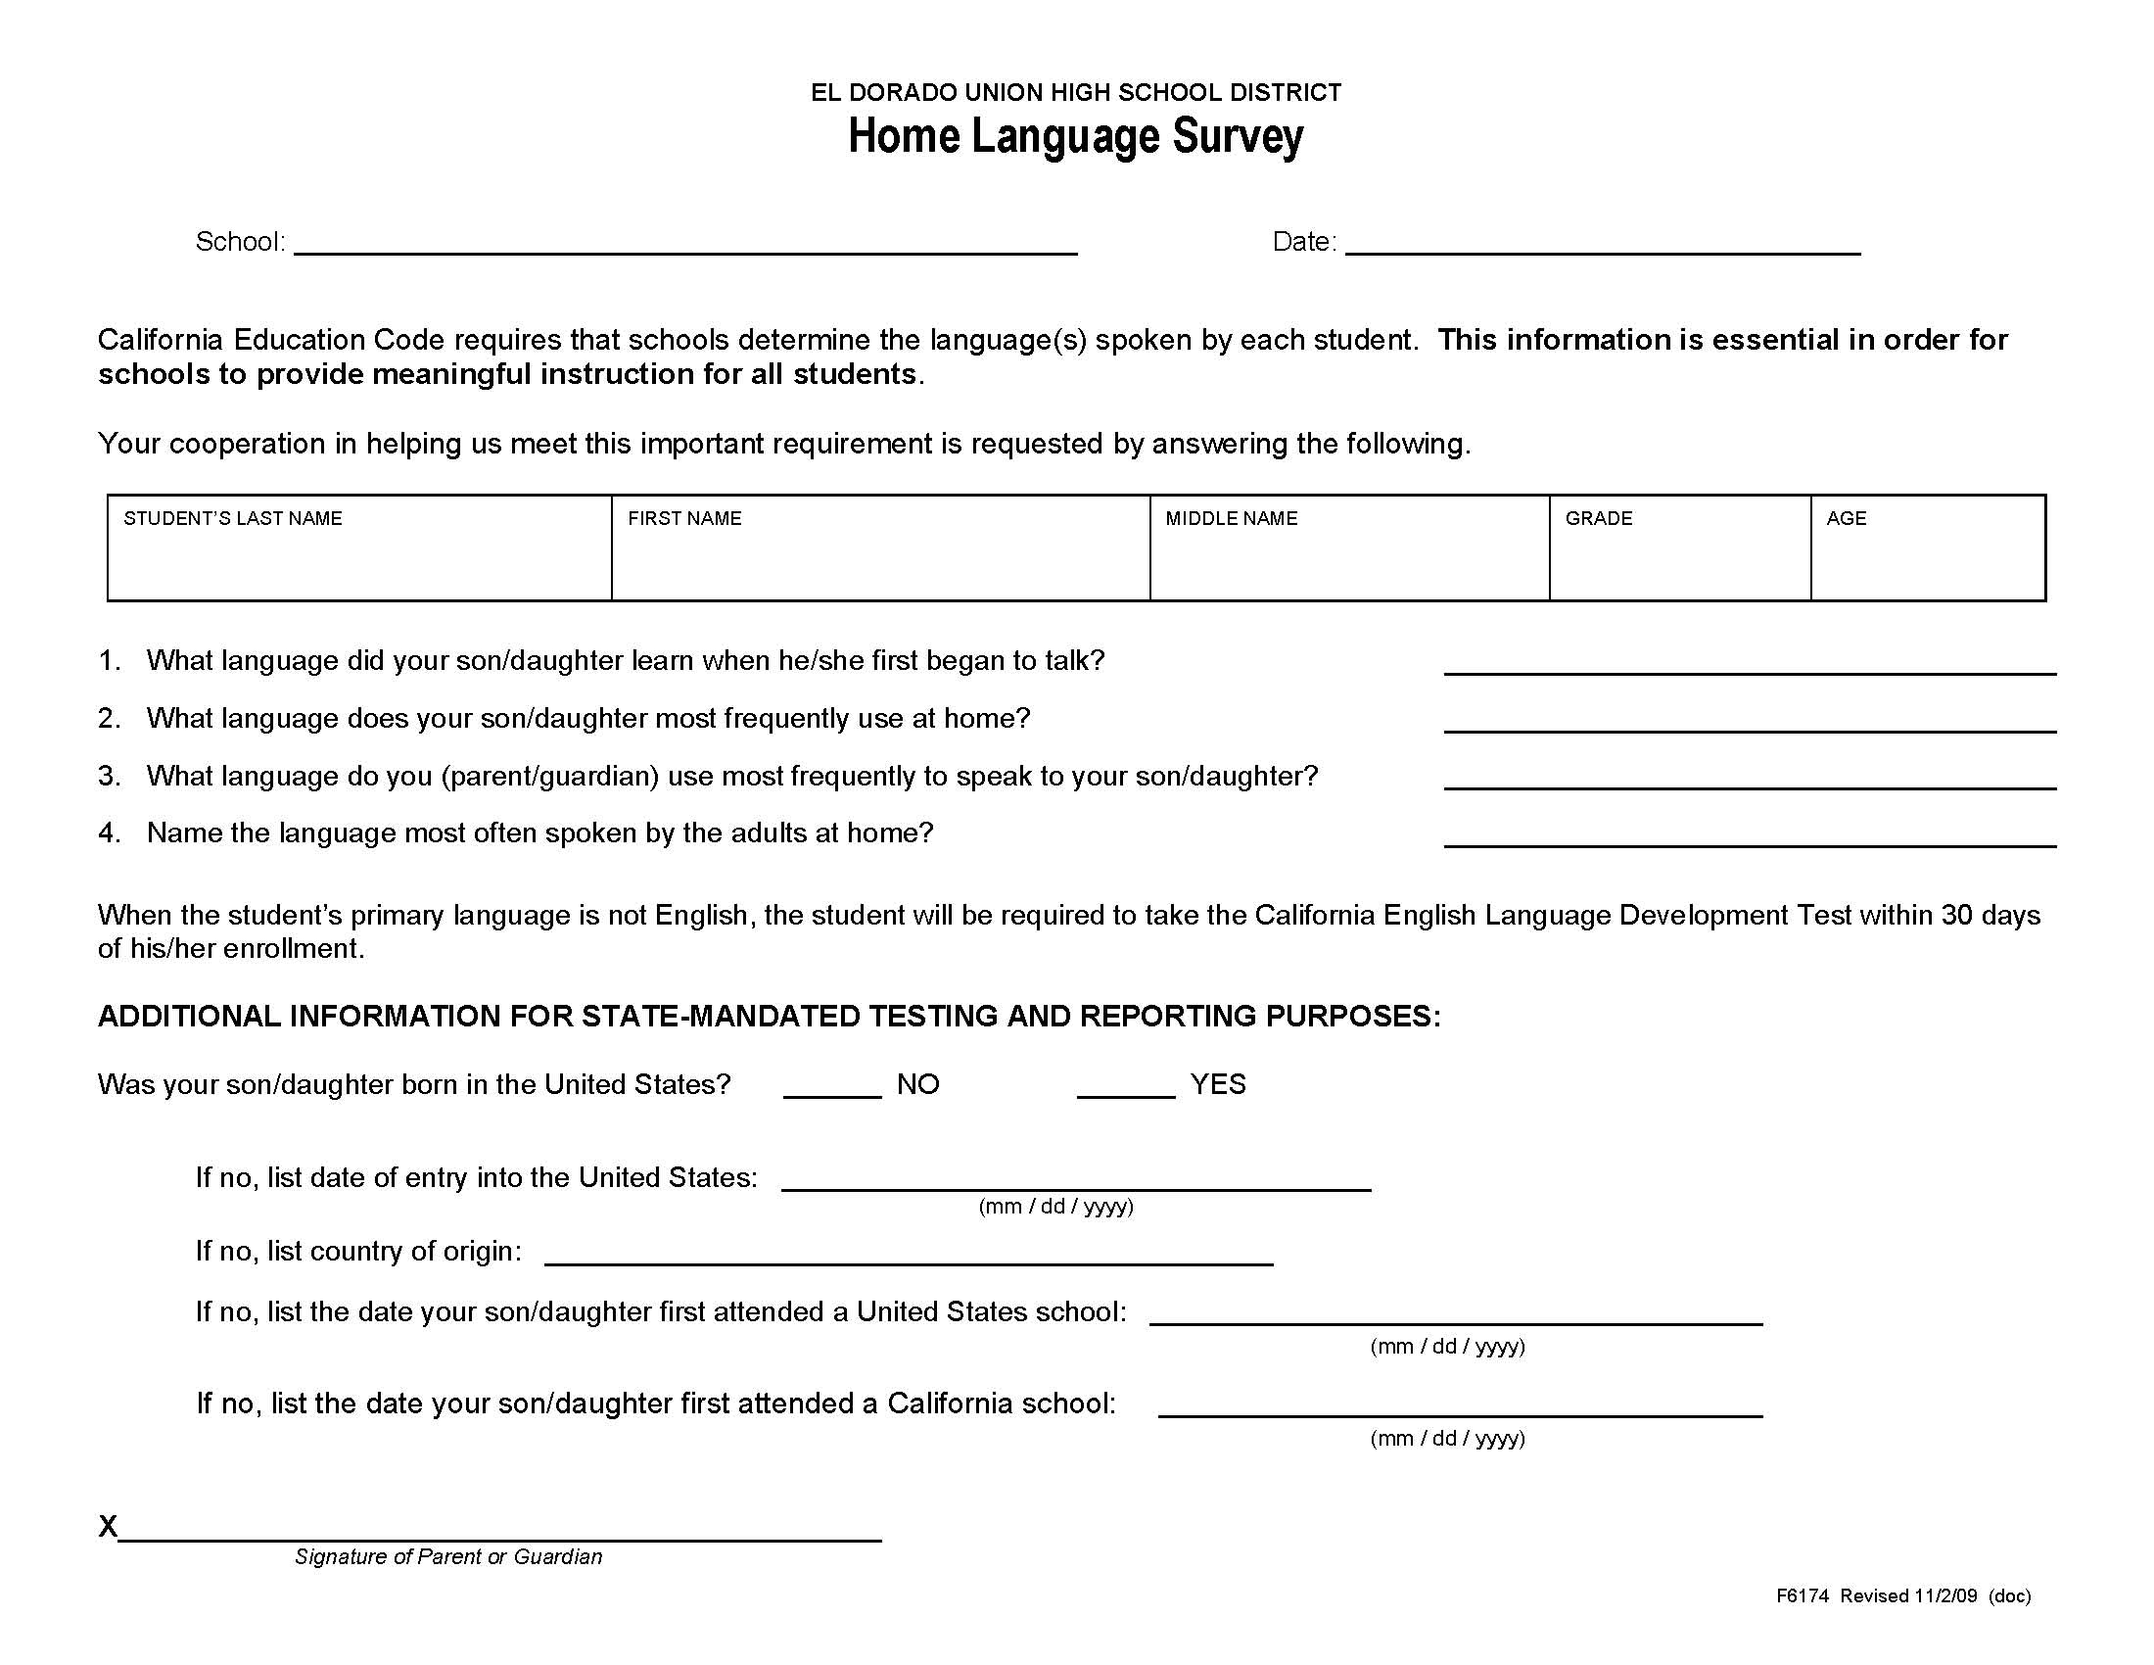

Slide 5
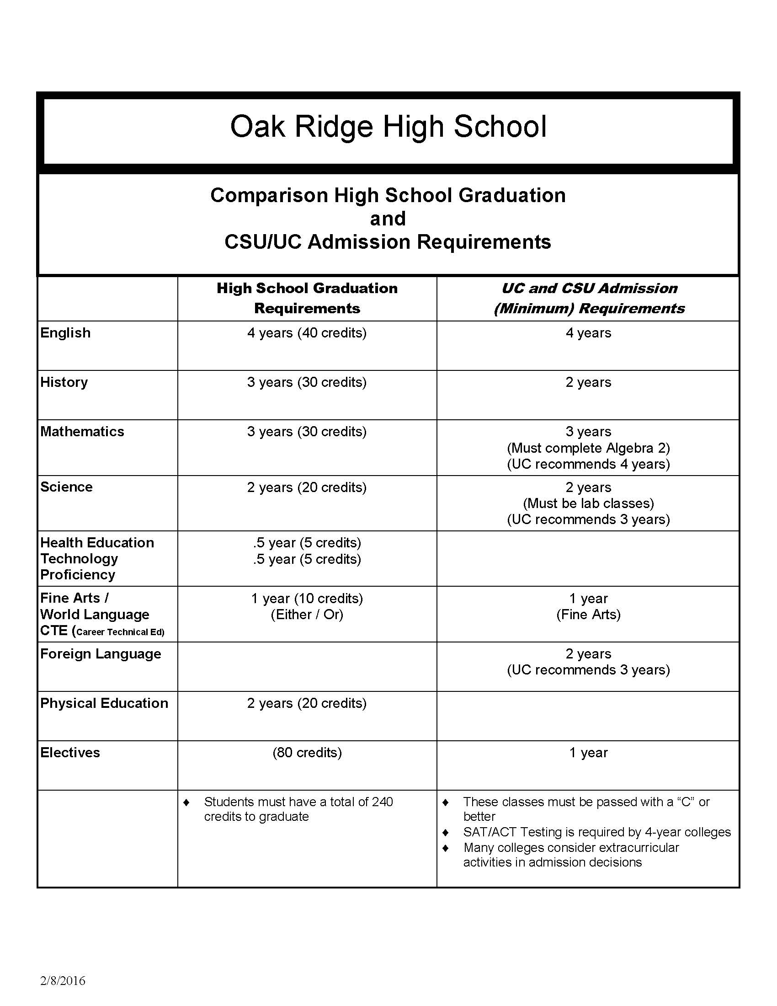

Slide 6
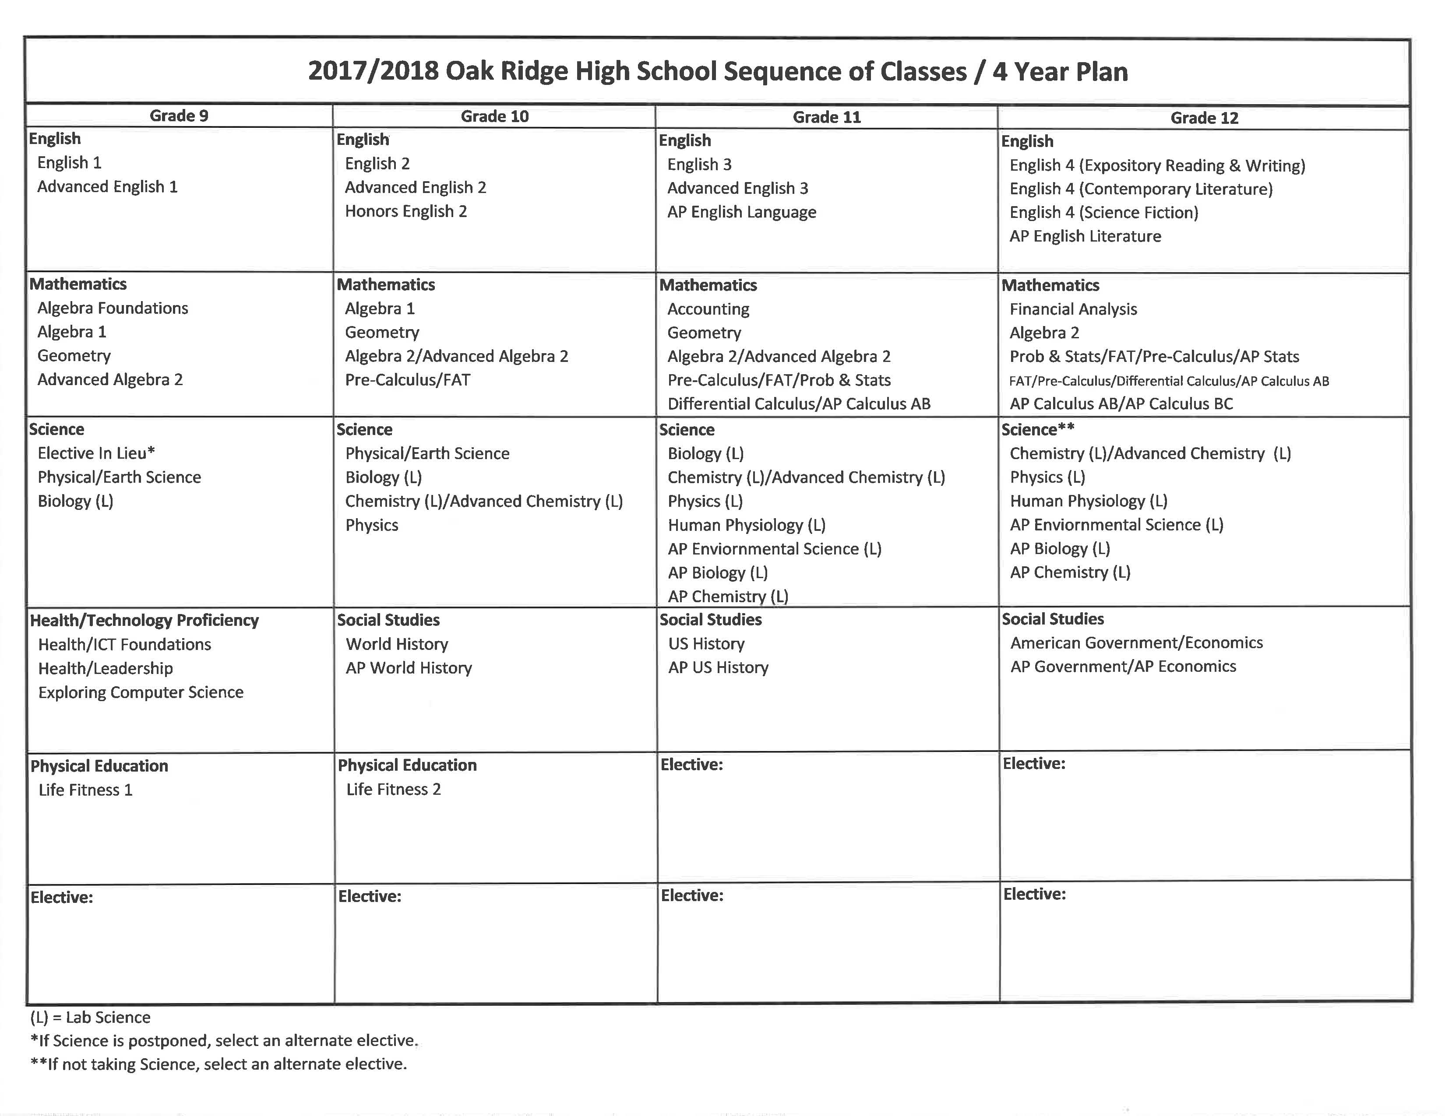
2014/2015 Oak Ridge High School Sequence of Classes / 4-Year Plan
Grade 9
Grade 10
Grade 11
Grade 12
English
English 1
Advanced English 1
English
English 2
Advanced English 2
Honors English 2
English
English 3
Advanced English 3
AP English Language
English
English 4 (Expository Reading & Writing)
English 4 (Contemporary Literature)
English 4 (Science Fiction)
AP English Literature
Mathematics
Algebra 1
Geometry
Algebra 2/Adv. Algebra 2
Mathematics
Geometry
Algebra 2/Adv. Algebra 2
Math Analysis
Mathematics
Algebra 2/Adv. Algebra 2
Math Analysis/Prob. & Stats
Differential Calculus/AP Calculus AB
Mathematics
Prob. & Stats/Math Analysis/AP Stats
Stats/AP Stats/Differential Calculus/AP Calculus AB
AP Calculus AB/AP Calculus BC
Science
Physical / Earth Science
Biology (L)
Science
Biology (L)
Chemistry (L) /Chemistry A (L)
Physics (L)
Science
Chemistry (L) /Chemistry A (L)
Physics (L) /Environmental Science (L)
Physiology (L)
A.P. Environmental Science (L)
A.P. Biology (L)
Science
Chemistry (L) /Chemistry A (L)
Physics (L) /AP Physics (L) /Environmental Science (L)
Physiology (L)
A.P. Environmental Science (L)
AP Biology (L)
Health / ICT Foundations
Health / Leadership
Social Studies
World History
A.P. World History
Social Studies
US History
AP US History
Social Studies
American Government / Economics
AP Government /AP Economics
Physical Education
Life Fitness 1
Physical Education
Life Fitness 2
Elective:
____________________________
Elective:
____________________________________
Elective:
_________________________
Elective:
__________________________
Elective:
___________________________
Elective:
____________________________________
( L ) = Lab Science
Parent Signature ______________________________________ Date____________________________
Student Signature ______________________________________ Date____________________________

Slide 7
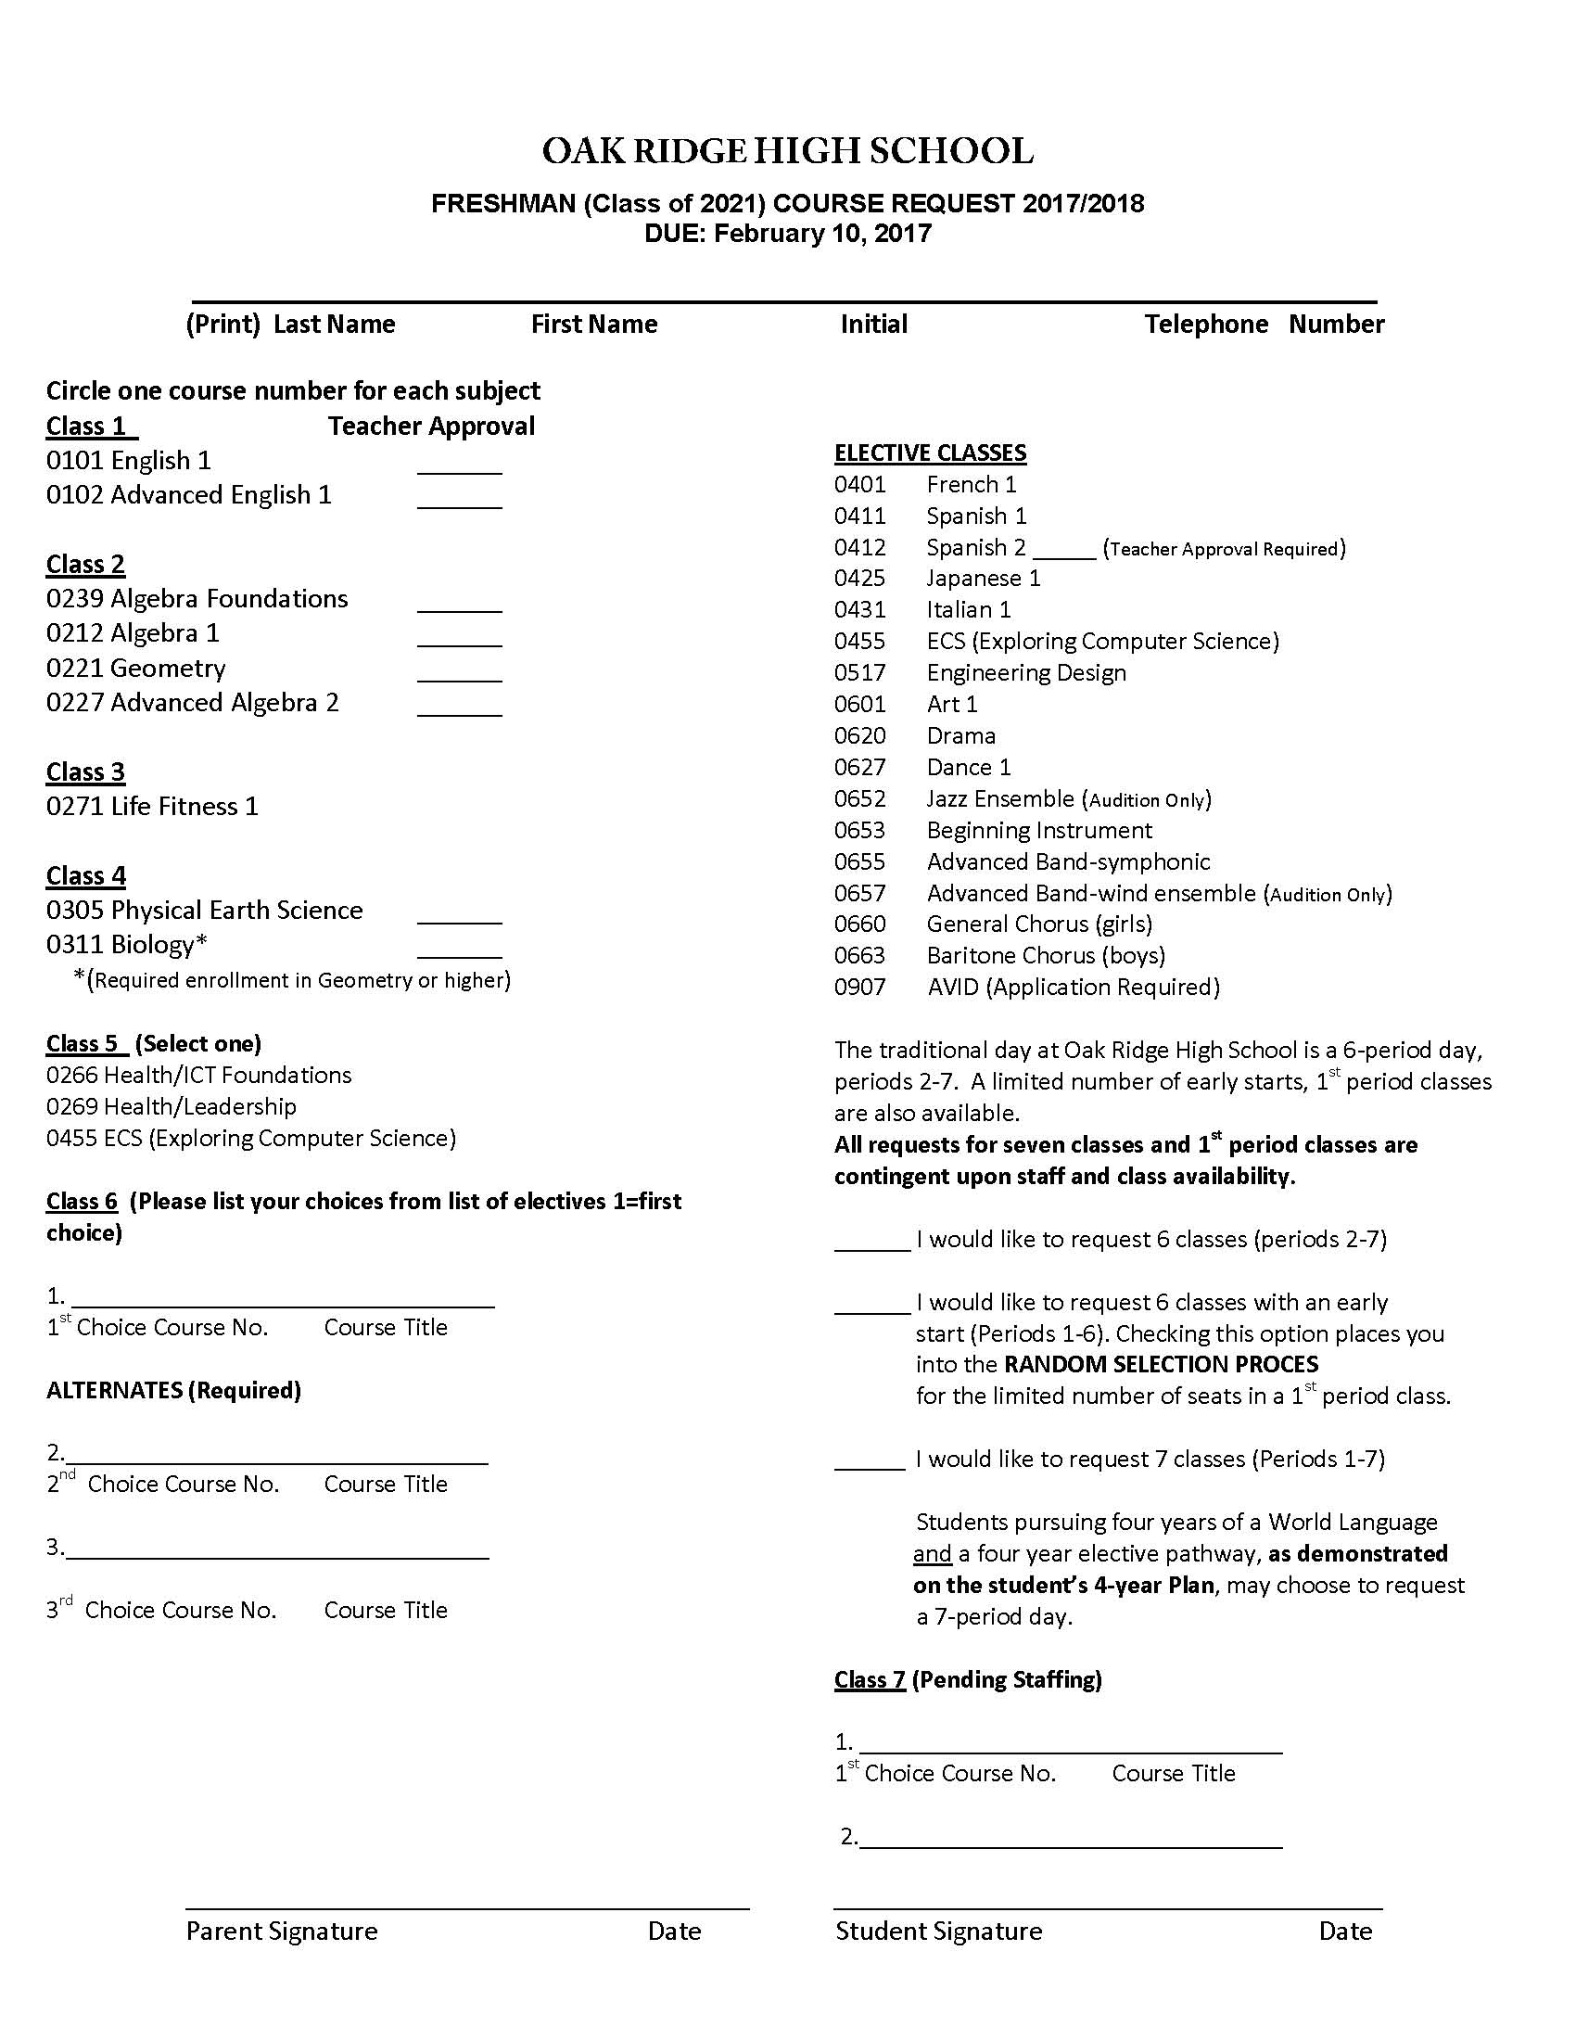

Slide 8
Upcoming Events/Opportunities
Spring Mailer to Include:
17/18 Class Selections (no periods
Date of New Student/Parent Orientation – to occur in August of 2017 *First day of school in 17/18 TBD by school board at Feb. 14th board meeting.
Summer Mailer to Include:
Parent Portal/ Aeries* Account Activation Information and Instructions
Input contacts and emergency info online
Sign Technology User Agreement Form
*Note – more information on Aeries will be provided at New Student/Parent Orientation.
New Student/Parent Orientation (date TBD)
Student schedule distribution
Tours of Campus
Request Lockers
Parent Orientation – Aeries Portal, transportation, finance dept (food services, ASB, PE Uniforms, etc).

Slide 9
Counselors will begin working with your student as early as the Fall of 2017!
9th grade level meetings for students and parents in Sept/Oct 2017 (more information will be provided in the Fall)
Graduation Requirements, College Admissions Requirements, Naviance, etc.
Post Secondary planning meetings with families are by appt. Encourage to wait to make appt until after grade level meetings.
Counselors are available at breaks and lunches to speak to students (located around campus)! Have your student come by at the start of next year to meet their counselor!!!

Slide 10
9th Grade Math Level Placement
Placement is determined by the criteria set forth on the EDUHSD 9th Grade Placement Policy
Please speak to your students current math teacher if you have any questions. More detailed information about math placement will be provided on the ORHS website (orhs.eduhsd.k12.ca.us) under the Counseling tab and at the district website at (www.eduhsd.k12.ca.us) after April 1st
Members of the math department will also be available to speak to you tonight (2/6) in room R206 from 6-7:30pm

Slide 11
The Importance of 9th Grade
Handouts
Open House Information Sheet and Locater
Communication
Aeries
Encourage communication between student and teacher
Encourage your student to meet annually with their counselor
Academic Performance
Time management
Balance
Involvement in clubs/sports/extra-curricular activities

Slide 12
Activities Director Lauren Handler
ASB
Clubs
Health/Leadership

Slide 13
Athletic Director Steve White
Sports Physical Night is 5/9/17 – more info online
Freshman Sports Night TBD
Website: trojanpride.com

Slide 14


Slide 15

This presentation will be available to view online at:
orhs.eduhsd.k12.ca.us

